Slide 1
Procedures -- Logo
L.O. "Create a procedural program."

Slide 2
Procedures -- Logo
A procedure is like a recipe -- a recipe of instructions. A procedure for an omelette might look like this:
OMELETTE:
Crack the eggs
Add a pinch of salt and pepper
Beat the eggs
Heat the frying pan
Add the butter
Add the eggs
Cook until brown underneath
Fold in half
Serve
Eat!

Slide 3
Procedures -- Logo
A procedure can be used anywhere in your Logo program by simply typing its name.

Slide 4
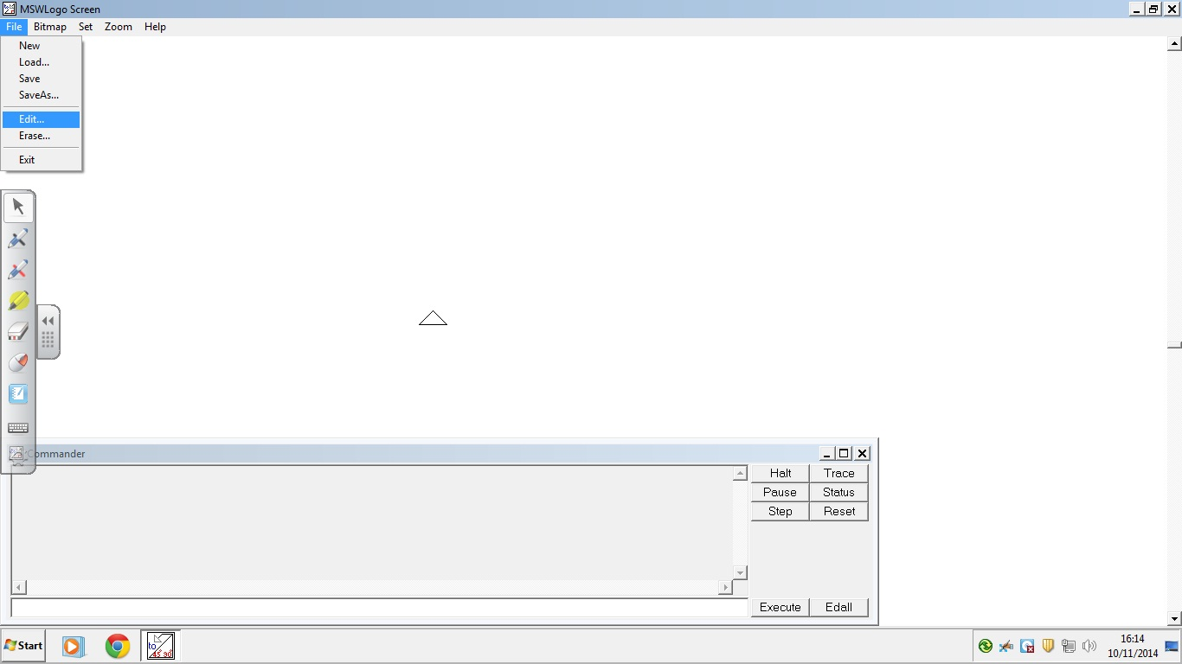
Procedures -- Logo
Go to File/Edit.

Slide 5
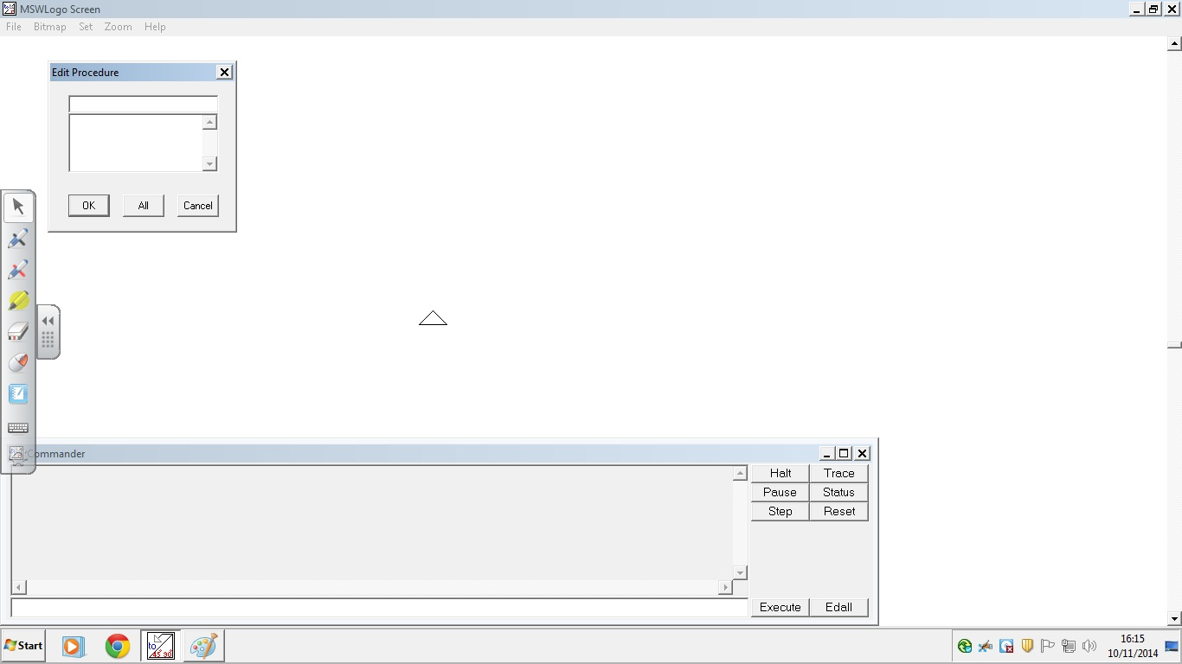
Procedures -- Logo
The Edit Procedure box should open.

Slide 6

Procedures -- Logo
Give your procedure a name.

Slide 7
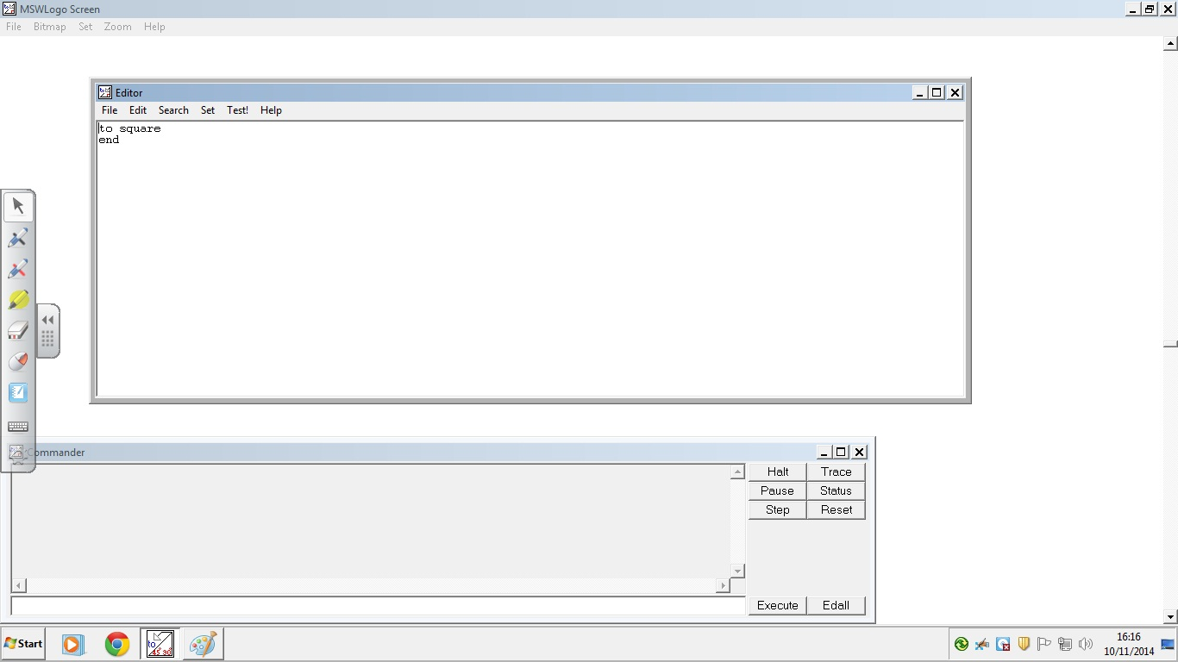
Procedures -- Logo
Leave the two lines intact. Type your code between them.

Slide 8
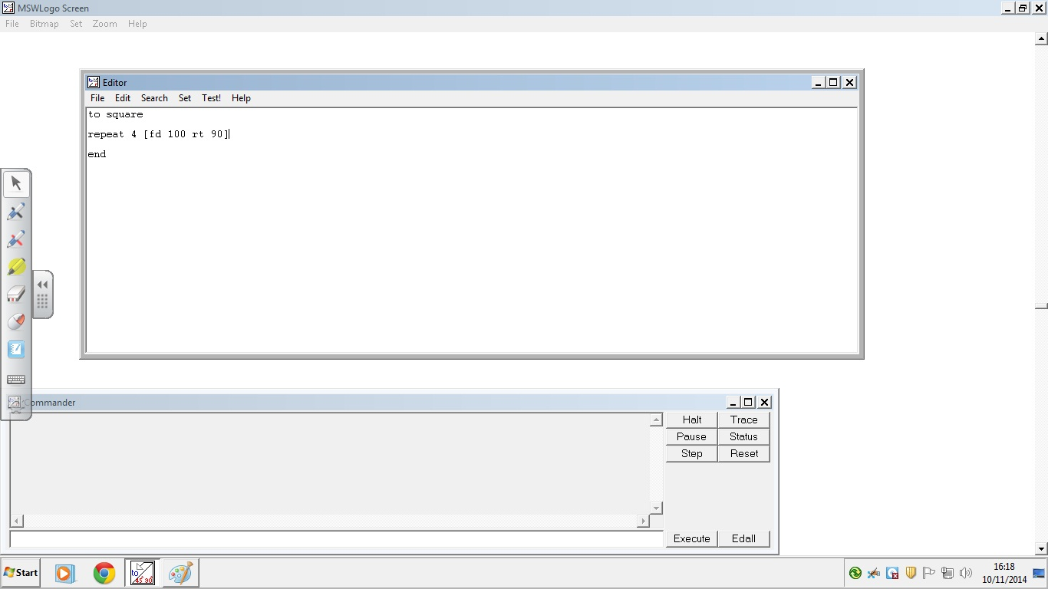
Procedures -- Logo

Slide 9
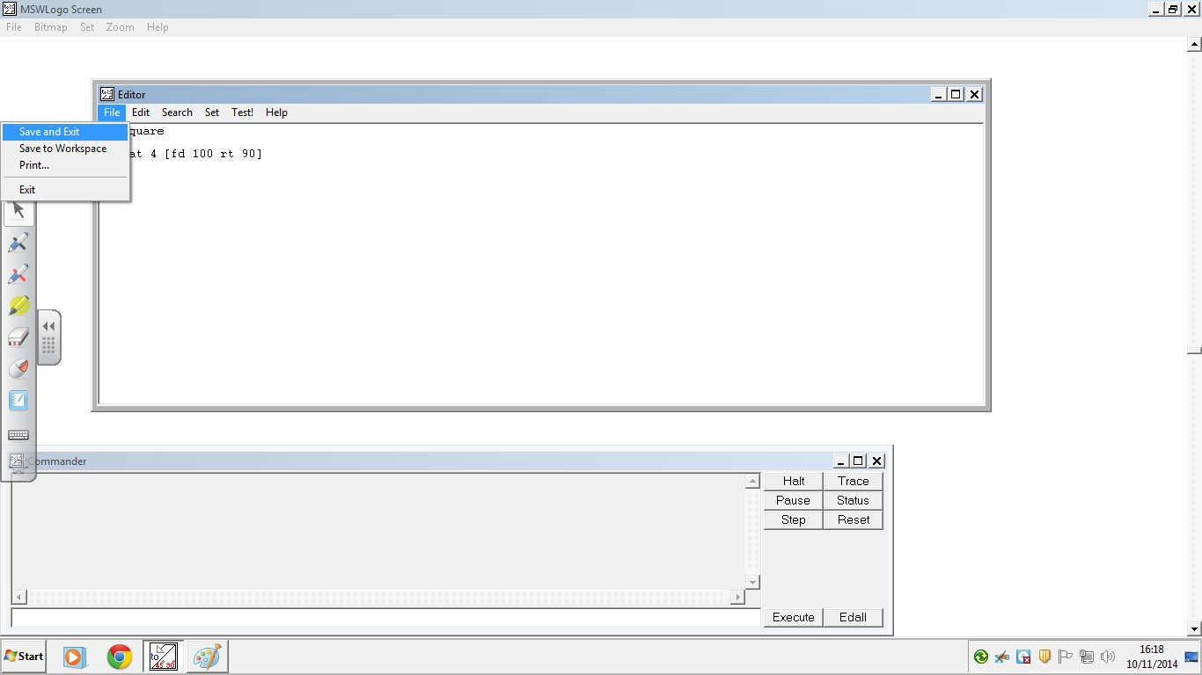
Procedures -- Logo
When you have finished, go to File/Save and Exit.

Slide 10
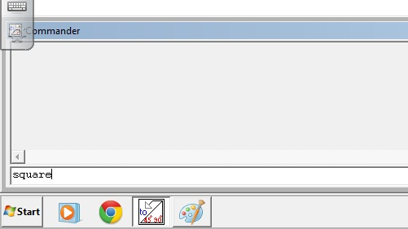
Procedures -- Logo
Now, to draw your shape, just type the procedure name on the command line.

Slide 11
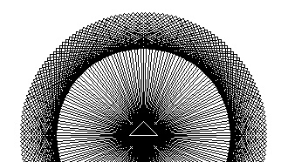
Procedures -- Logo
What happens if you type the following:
REPEAT 180 [RT 2 SQUARE]

Slide 12
Procedures -- Logo
What happens if you try different values for REPEAT and RT?
REPEAT ??? [RT ? SQUARE]

Slide 13
Procedures -- Logo
Now, create a procedure for another shape and create a new, repeating pattern like we just did using the square.

Slide 14
Procedures -- Logo
Can you create a pattern using more than one shape?

Slide 15
Creating Procedures
File/Edit
Type in a name
Click OK
Type between these lines
This is your new procedure
File/Save and Exit

Slide 16
Programming Vocabulary
Sequence: a logical list of instructions
Loop: a sequence that is repeated
Nested loop: a loop within a loop
Procedure: a collection of instructions
Variable: a value that can be changed

